Slide 1
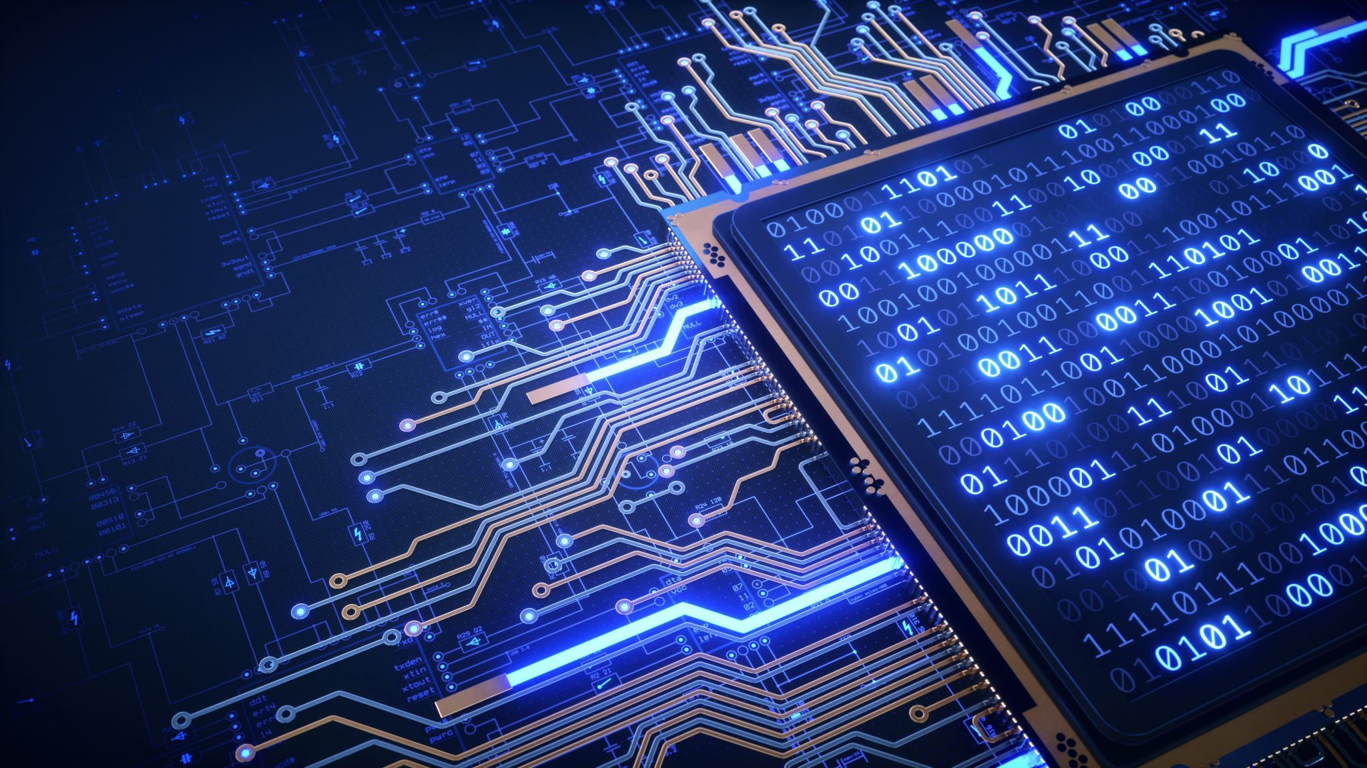
COLOUR DETECTION USING PYTHON
2010030015-ANIL KUMAR
2010030020-SAI RISHAL
2010030288-DILEEP SAI LAVU
2010030343-SIMON SUMANTH

Slide 2

ABSTRACT
In image processing and computer vision, it is common to find applications, in which it is necessary to detect reference points characterized by extreme color, i.e., a primary color RGB or complementary CMY with very high saturation. Thus, there are cases in which a certain class of objects can be distinguished according to their characteristic extreme color, which can be used as landmarks or to identify objects.

Slide 3

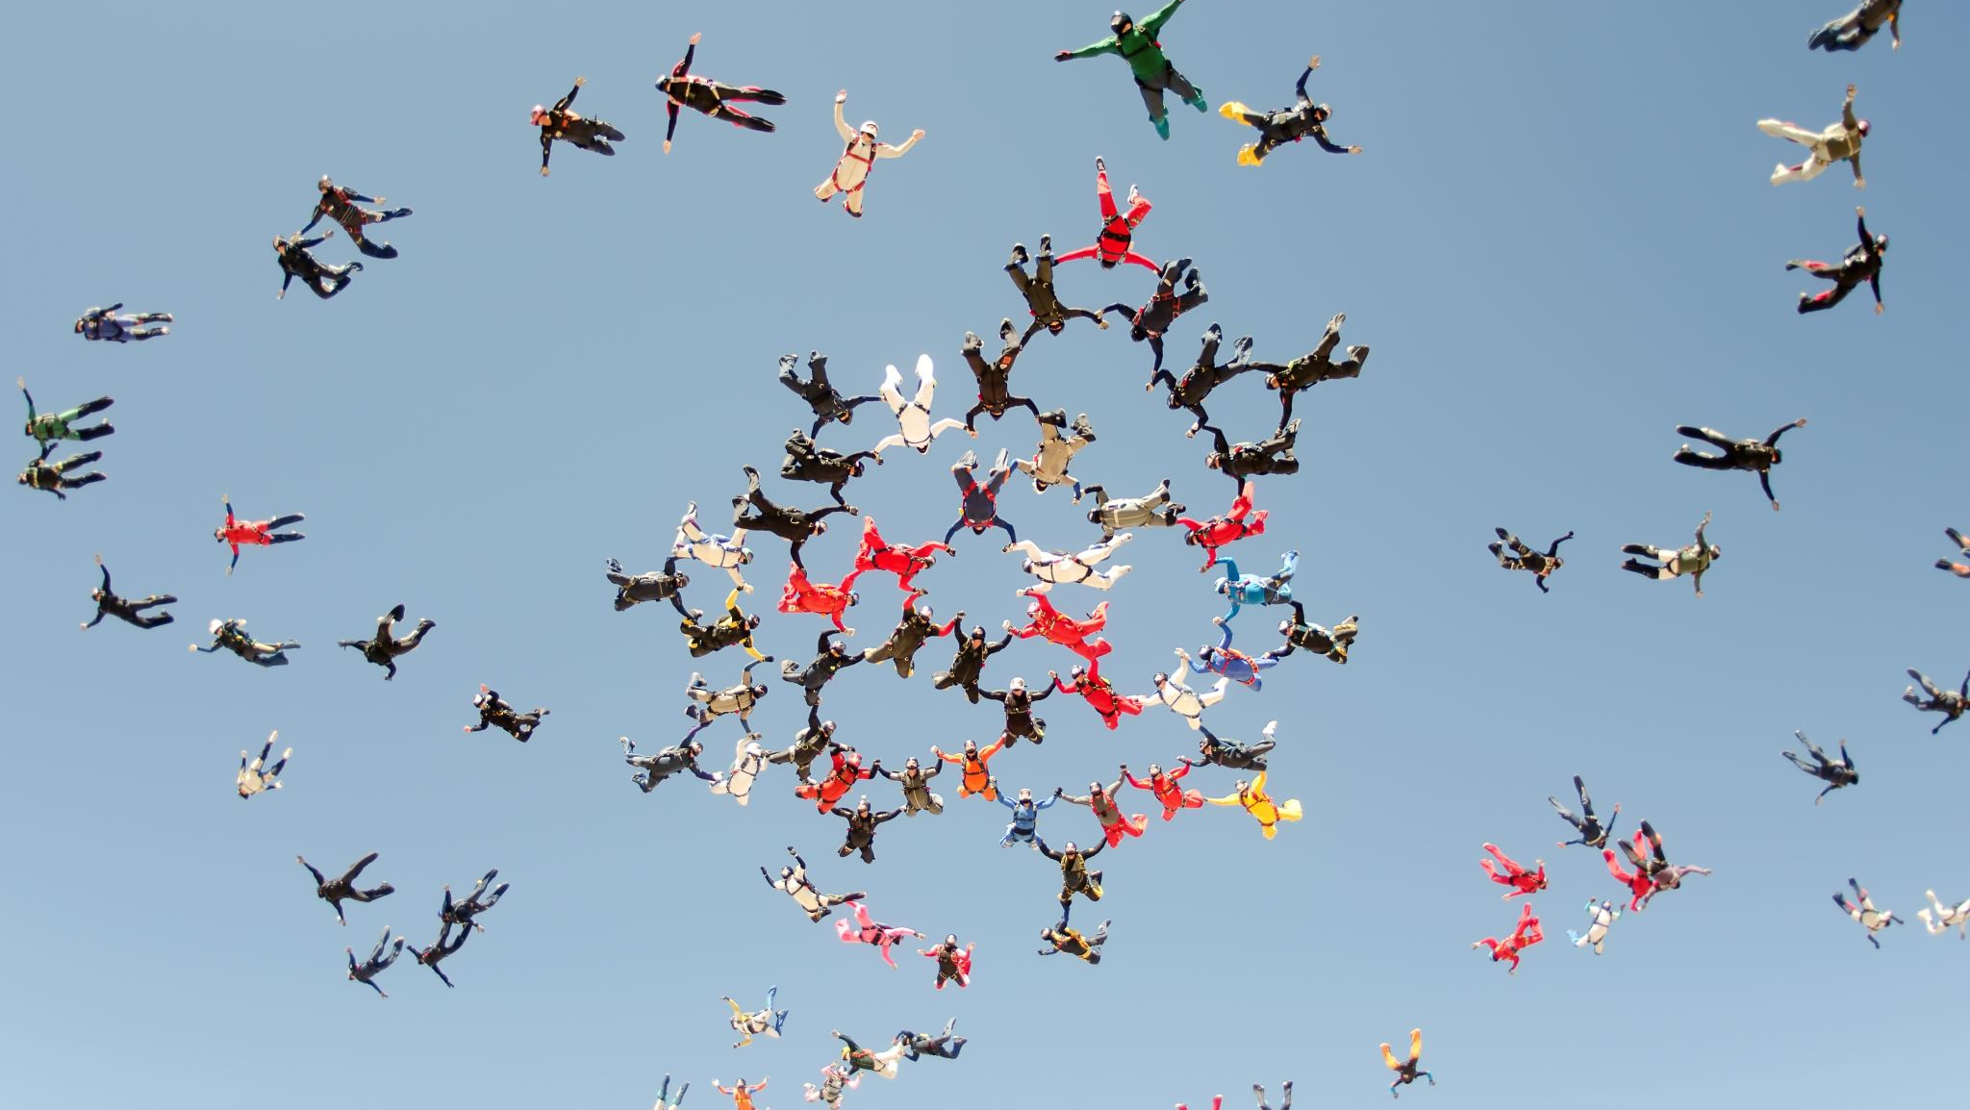
INTRODUCTION
Colour dection has several use cases in everyday life, It is being used for object segmentation, security enhancement, pedestrian tracking, counting the number of visitors, number of vehicles in traffic etc. It is able to learn and identify the foreground mask.
In this color detection Python project, we are going to build an application through which you can automatically get the name of the color by clicking on them. So for this, we will have a data file that contains the color name and its values.

Slide 4
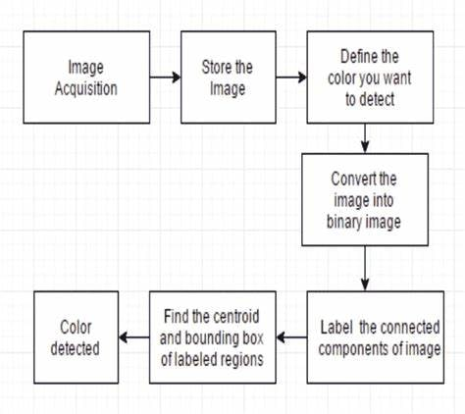
Flow Chart

Slide 5
Implementation

Slide 6
Steps for implementation
Feature Extraction: Perform feature extraction for getting the R, G, B Color Histogram values of images
1
Train KNN classifier by R, G, B Color Histogram values
2
Read Web Cam frame by frame, perform feature extraction on each frame and then classify the mean color of it.
3

Slide 7
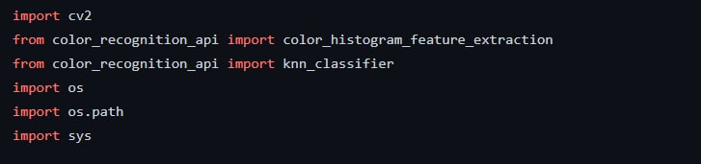
Packages need to be installed

Slide 8
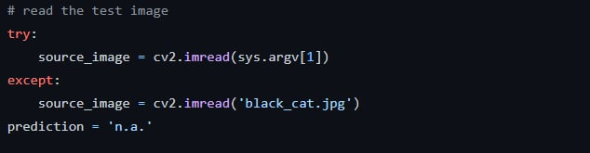
Reading image/Input

Slide 9
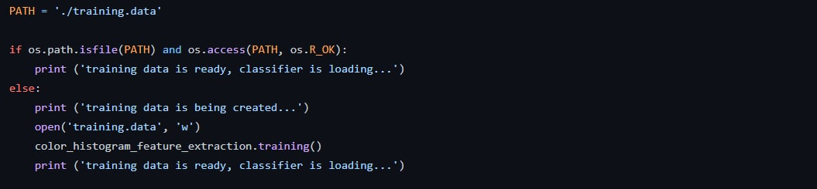
Extracting from the dataset

Slide 10
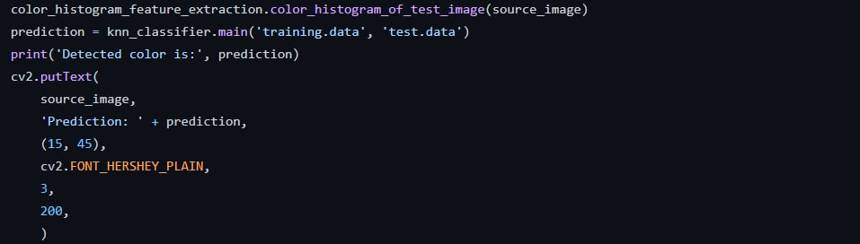
Prediction of the colour

Slide 11

Displaying output

Slide 12
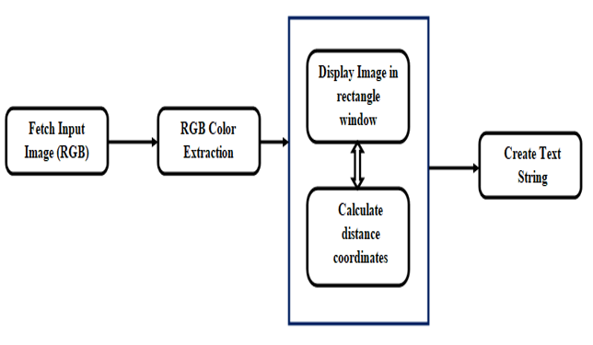
WORK IN PROGRESS

Slide 13
CONCLUSION
In this paper we defined to get the required color field from an RGB image. In this various steps are implemented using openCv platform. The main positive point of this method is its color differentiation of a mono color.
We are trying to detect of the edge detection techniques has different other applications like facial detection, color conversion for grey scale image etc. that can also be implemented.

Slide 14
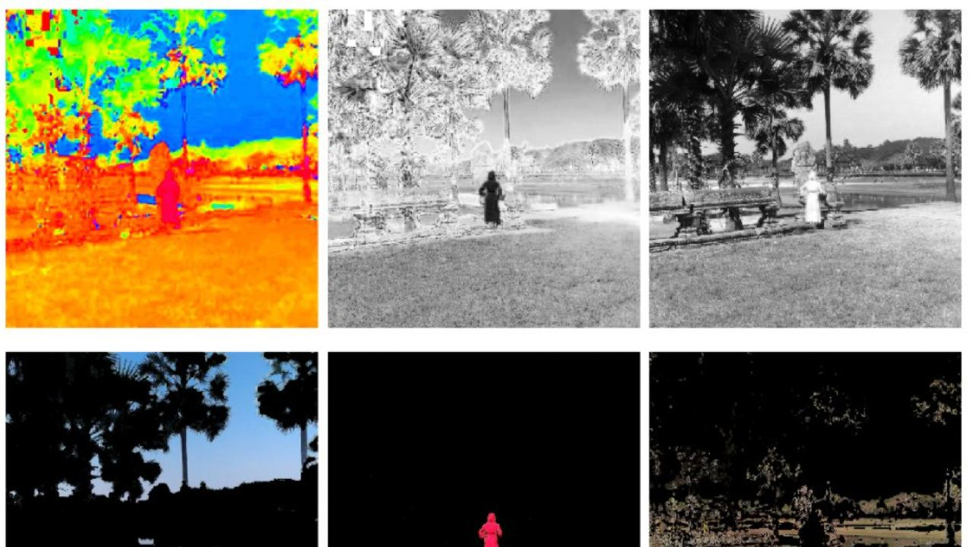

Slide 15
Thank you

